Slide 1

SAP SYSTEM

Slide 2
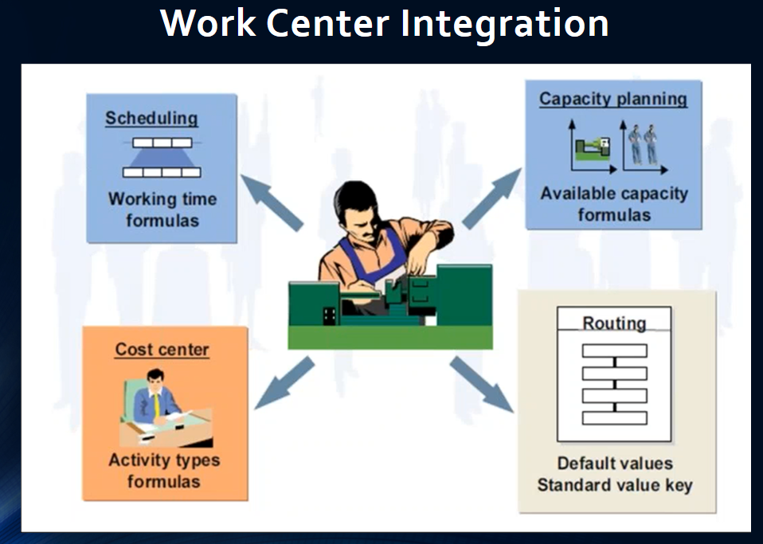
Work Center in SAP

Slide 3
First Step: Identifying Labor Cost/ Hour & Electricity Cost/ Hour
Table: A sample Calculation for identifying Labor Cost & Electricity Cost.
Work Center Name | O/P per Shift | Electricity Consumption (KWH) / Shift | Rate/ KWH | Labor Requirement in Nos | Permanent Employee in Nos | Activity Cost for Labor / Month | Activity Cost for permanent Employee / Month | Labor Rate/ Hour | Permanent Employee Rate / Hour | Total Manpower cost / Hour | Electricity Cost / Hour
Biscuit Line | 10.67 MT | 1739 KW | 5.44 | 143 | 21 | =143*5600 =800800 | =Gross salary of 21 permanent Employee =576434 | =800800/25/8 =4004.00 | =576434/25/8 =2882.17 | =4004+2882.17 =6886 | =1739*5.44/8 =1182

Slide 4
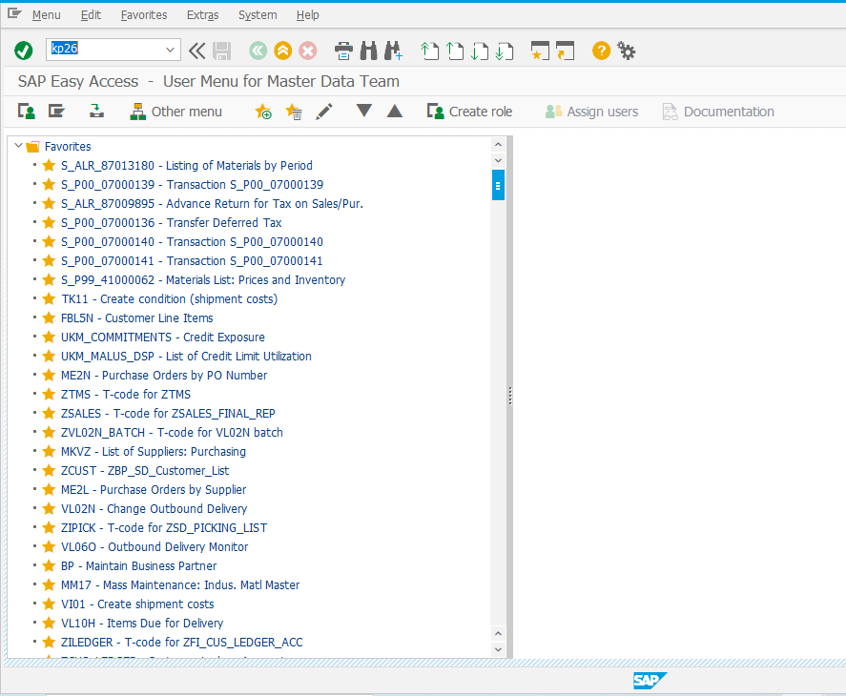
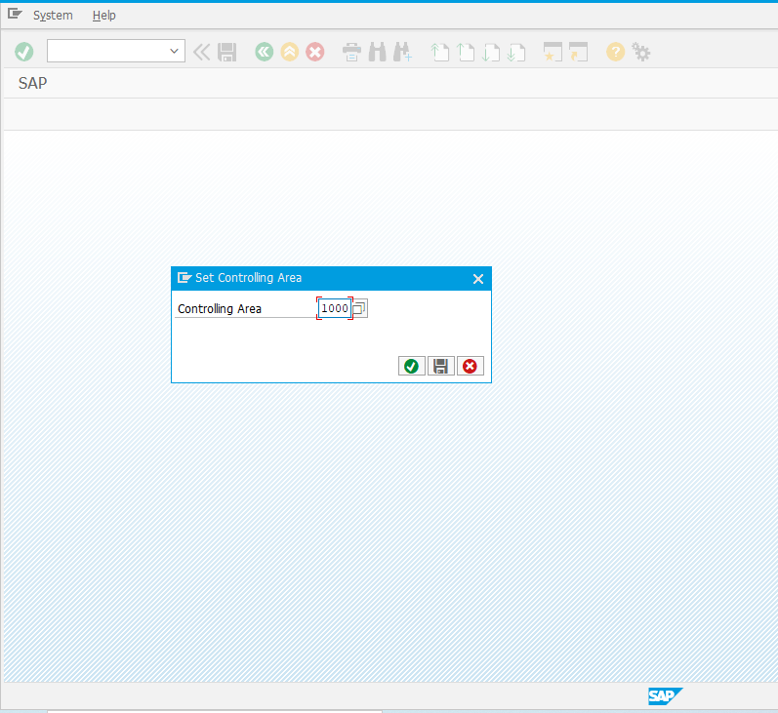
Second Step: KP26 Price Maintain in SAP
Hit KP26
Controlling Area: 1000

Slide 5
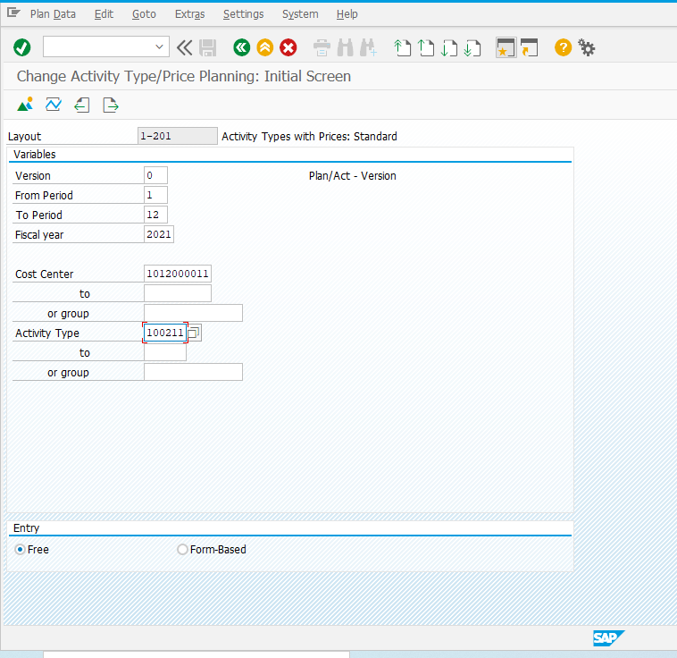
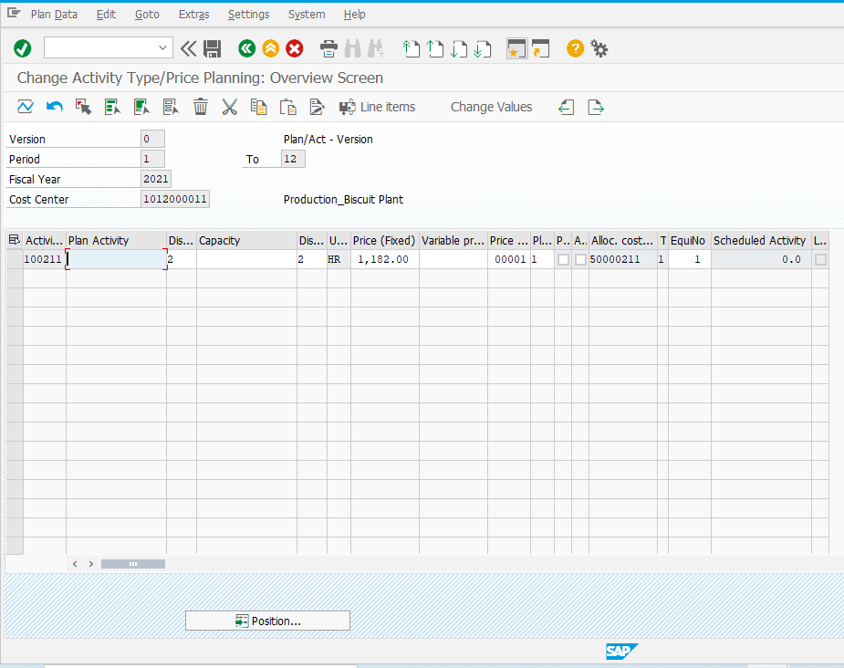
Second Step: KP26 Price Maintain for Electricity Cost in SAP
Click Overview
Version: o
From Period: 1
To Period: 12
Fiscal Year: 2021 (Choice)
Cost Center: 1012000011 for Biscuit
Activity Type: 100211 for Electricity Cost
Change Fixed Price

Slide 6
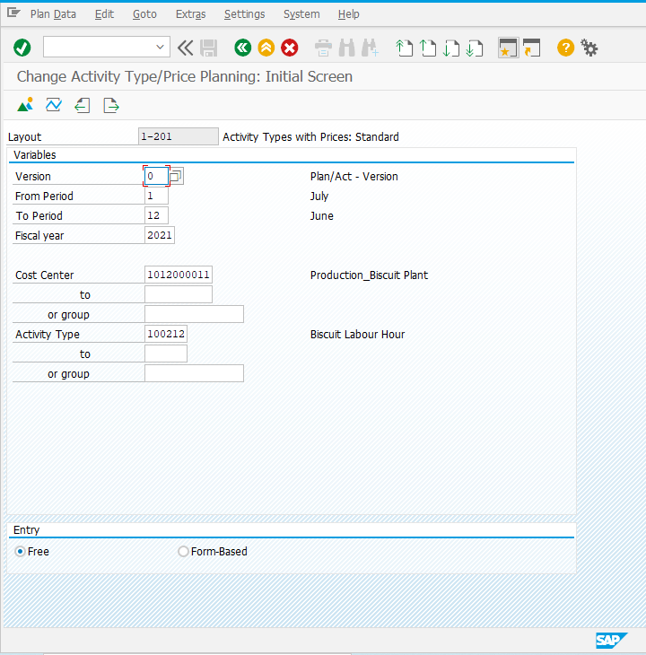
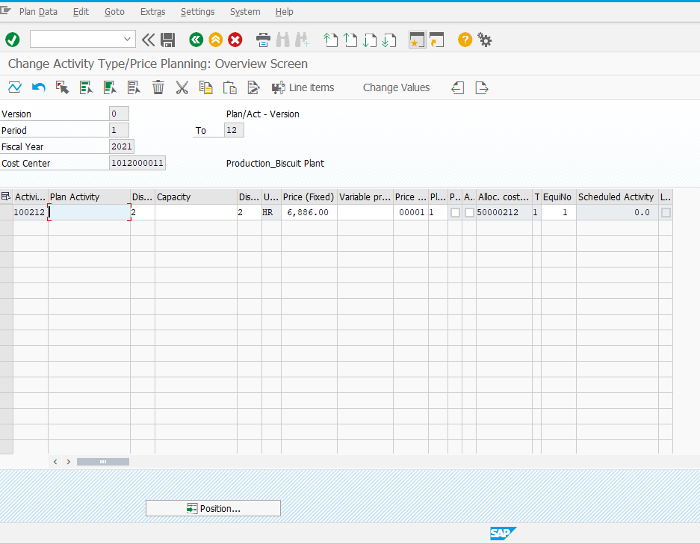
Second Step: KP26 Price Maintain for Labor Cost in SAP
Click Overview
Version: o
From Period: 1
To Period: 12
Fiscal Year: 2021 (Choice)
Cost Center: 1012000011 for Biscuit
Activity Type: 100211 for Labor Cost
Change Fixed Price

Slide 7
Third Step: Work Center Creation
Work Center Creation : CRC1
Work Center Change : CRC2
Work Center Display : CRC3

Slide 8
List of Work Centers for 1000 plant in SAP
Sl. No. | Plant | Work Center | Work Center Description | Cost Center | Activity Type For Machine | Activity Type For Labour
1 | 1000 | BAKERY | Bakery Production Line | 1013000011 | 100221 | 100222
2 | 1000 | BISCUIT | Biscuit Production Line | 1012000011 | 100211 | 100212
3 | 1000 | CAKELINE | Cake Production Line | 1014000011 | 100231 | 100232
4 | 1000 | CHANACHR | Chanachur Production Line | 1016000011 | 100251 | 100252
5 | 1000 | CHIPSLIN | Chips Production Line | 1015000011 | 100241 | 100242
6 | 1000 | FLRCRUSH | Flour Crushing Line | 1011000011 | 100201 | 100202
7 | 1000 | FLRPACKG | Flour Packaging Line | 1011000011 | 100203 | 100204
8 | 1000 | INSTNOOD | Insta Noodles Production Line | 1017000011 | 100261 | 100262
9 | 1000 | POWDRINK | Powderdrinks Production Line | 1018000011 | 100271 | 100272
10 | 1000 | PUFFRICE | Puffed Rice Production Line | 1027000011 | 100293 | 100294
11 | 1000 | SPECLPAK | Special Packaging Prod Line | 1021000007 | 100291 | 100292
12 | 1000 | STCKNOOD | Stick Noodles Production Line | 1017000011 | 100263 | 100264
13 | 1000 | WATERCAP | Water Cap Injection Line | 1019000011 | 100281 | 100282
14 | 1000 | WBLOWING | Water Blowing Prod Line | 1019000011 | 100285 | 100286
15 | 1000 | WFILLING | Water Filling Prod Line | 1019000011 | 100287 | 100288
16 | 1000 | WPREFORM | Water Preform Prod Line | 1019000011 | 100283 | 100284

Slide 9
List of Work Centers for 2000 & 3000 plant in SAP
Sl. No. | Plant | Work Center | Work Center Description | Cost Center | Activity Type For Machine | Activity Type For Labour
1 | 2000 | SALTBULK | Salt Bulk Prod Line | 2011000011 | 200201 | 200202
2 | 2000 | SALTCP | SaltCP Prod Line | 2011000011 | 200203 | 200204
3 | 3000 | DISHWASH | IHCL DISH WASH WORK CENTER | 3015000011 | MACHIN | LABOUR
4 | 3000 | DMPLANT | DM Water Production Plant | 3022000011 | MACHIN | LABOUR
5 | 3000 | FLOORCLE | Floor Cleaner Production Line | 3013000011 | MACHIN | LABOUR
6 | 3000 | GLASSCLE | Glass Cleaner Production Line | 3016000011 | MACHIN | LABOUR
7 | 3000 | HANDWASH | Hand Wash Production Line | 3012000011 | MACHIN | LABOUR
8 | 3000 | MOTORWAS | Motor Wash Production Line | 3017000011 | MACHIN | LABOUR
9 | 3000 | MULTISUR | Multi Surface Cleaner Line | 3014000011 | MACHIN | LABOUR

Slide 10
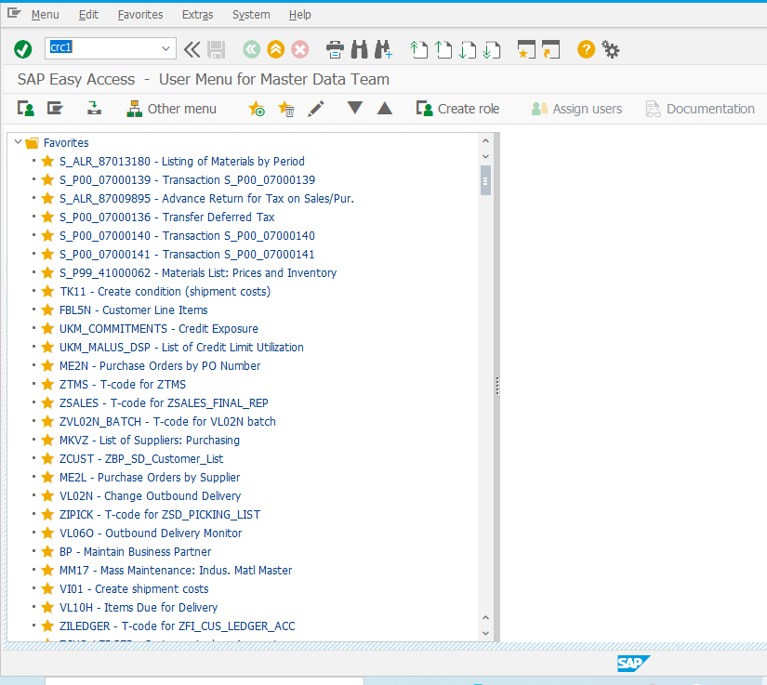
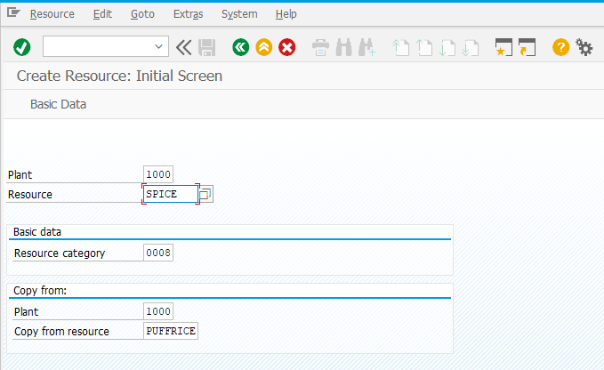
Work Center Creation (CRC1)
Plant: 100/200/300
Resource: Work Center Code (Suppose Spice for Spice Plant)
Resource Category: 008
Copy from:
If You want to create resource for 1000 plant then copy any resource of 1000 plant.
Hit CRC1

Slide 11
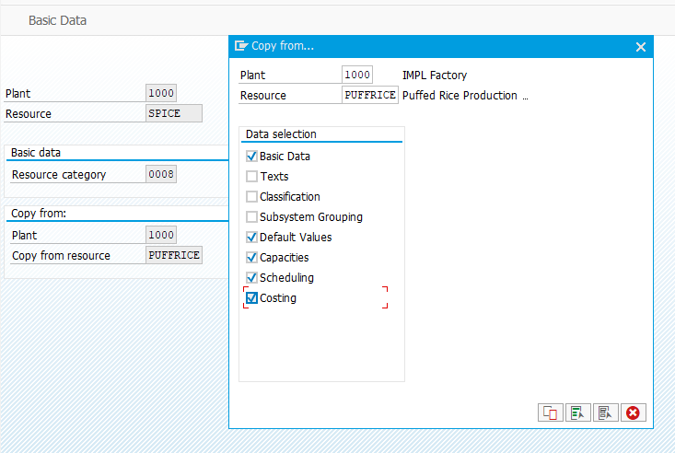
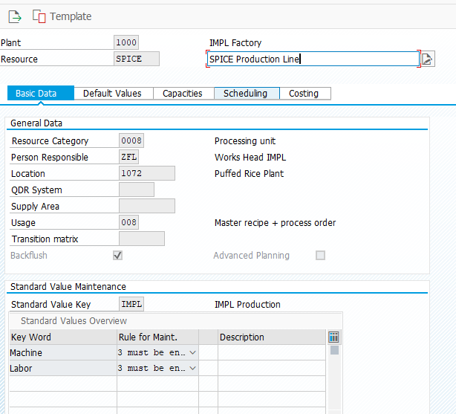
Work Center Creation (CRC1) Cont…
Select
1. Basic Data
2. Default Values
3. Capacities
4. Scheduling
5. Costing
Then Click on Copy
Need not to change Default Value Tab, Capacities Tab & Scheduling Tab.
In Basic Data Tab: Give Description of the work center.

Slide 12
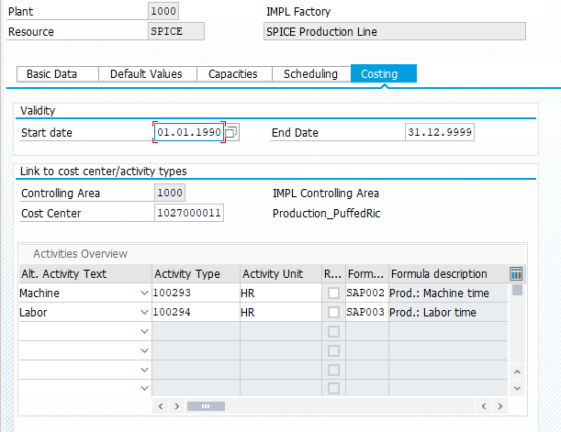
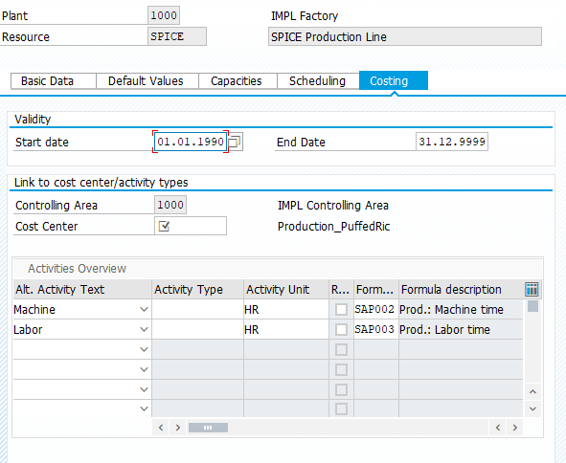
Work Center Creation (CRC1) Cont…
Accounts department will give you cost center for that work center and you have to put it here.
Go to Costing Tab.
You will find Copy materials Cost center & Activity Type
Accounts department will give you activity type for labor and machine, you have to put it here.
After Completing costing Tab, Save the work center.

Slide 13
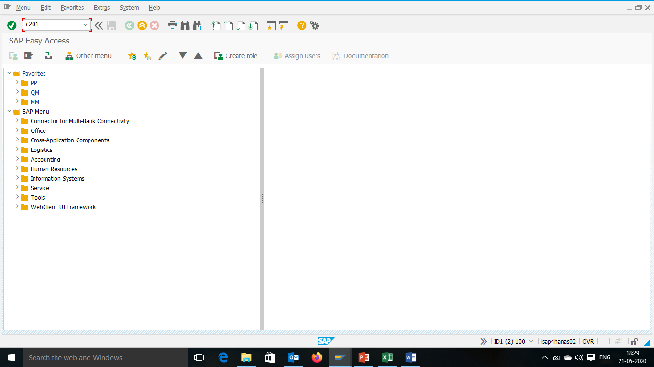
ROUTING in SAP (C201)
Hit: C201

Slide 14
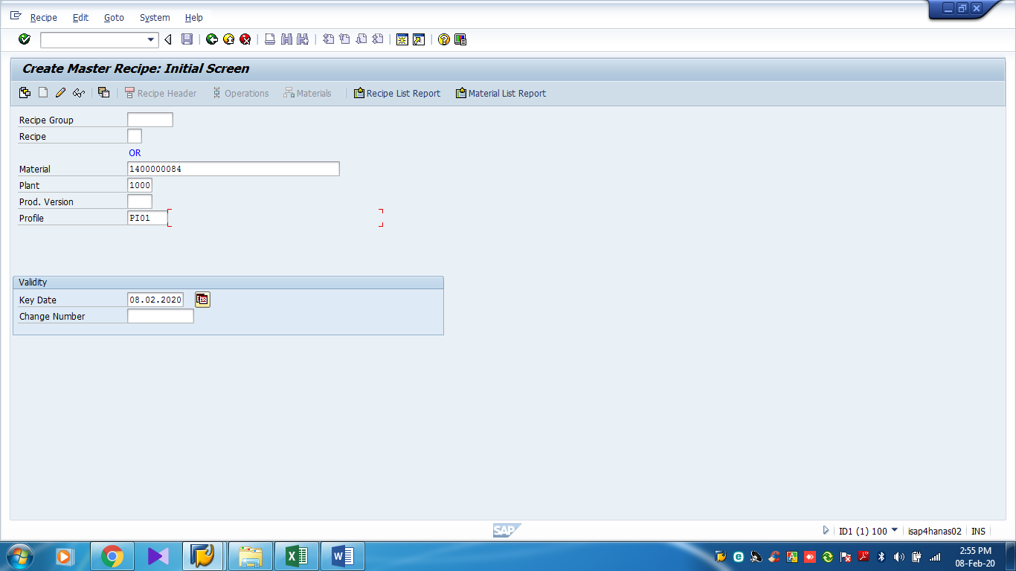
ROUTING in SAP (C201) Cont…
Give: Material Code, Plant & Profile: PI01

Slide 15
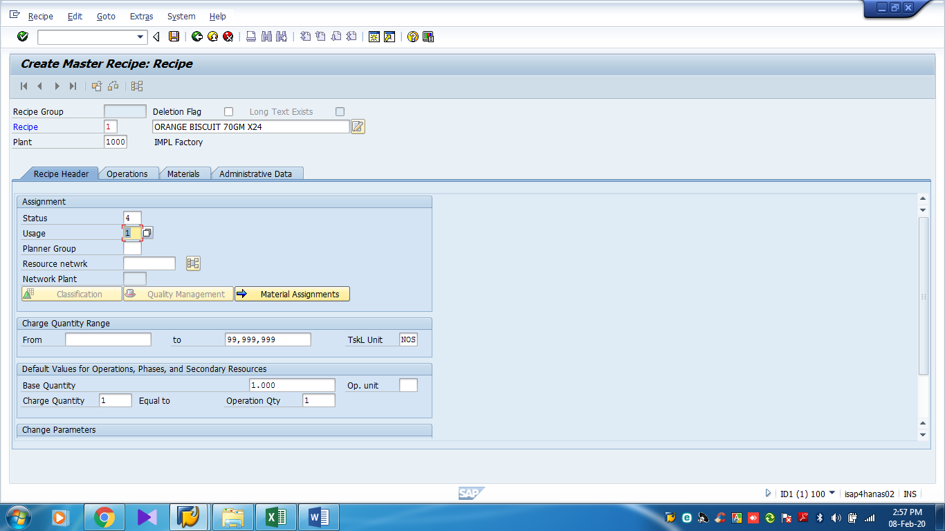
ROUTING in SAP (C201) Cont…
Give Status 4 & usage 1

Slide 16
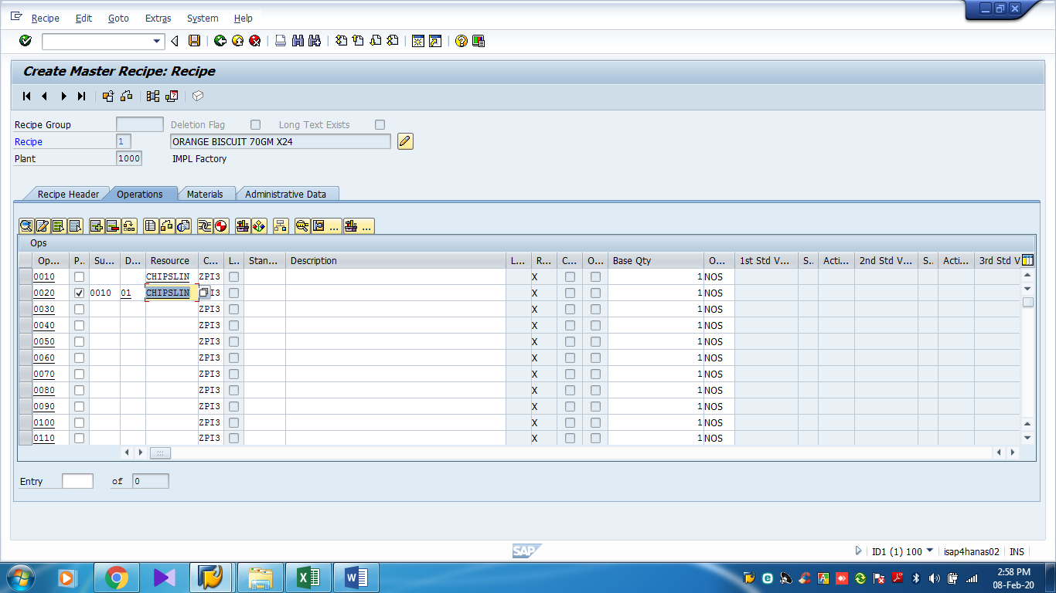
ROUTING in SAP (C201) Cont…
Give Work centre Code
Select Sub Operation: 0010 Destination: 01

Slide 17
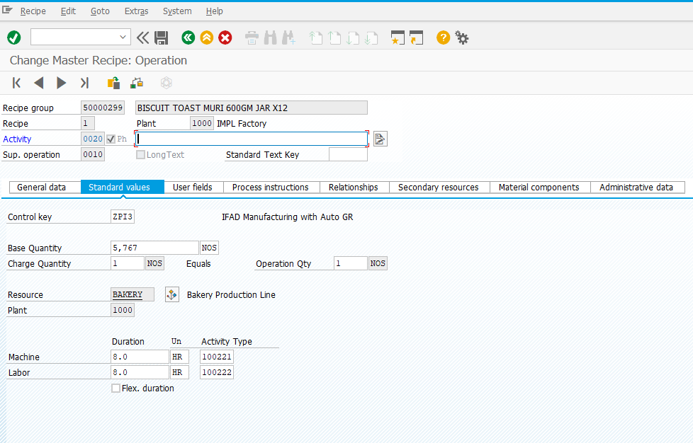
ROUTING in SAP (C201) Cont…
Save
Give Base Quantity
Give Labor Hour and Machine Hour

Slide 18

Production Version in SAP (C223)
Hit: C223

Slide 19
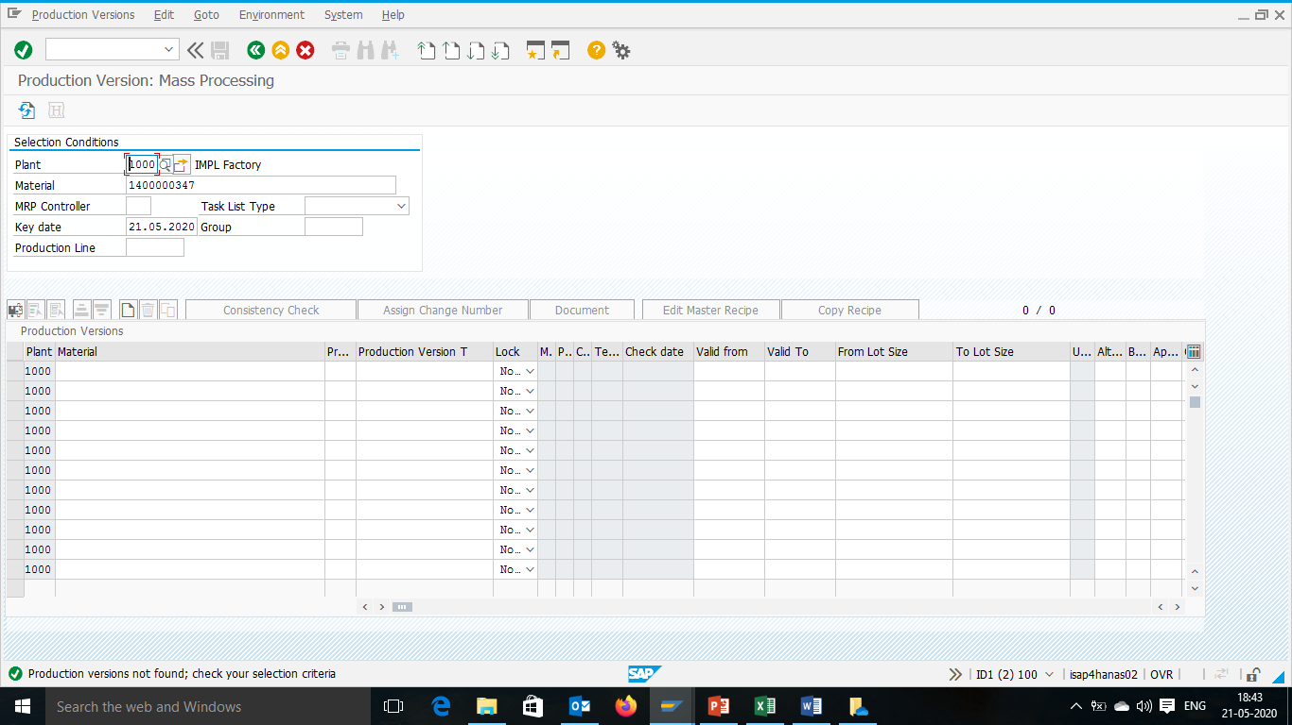
Production Version in SAP (C223) Cont….
Select Materail
Select New

Slide 20
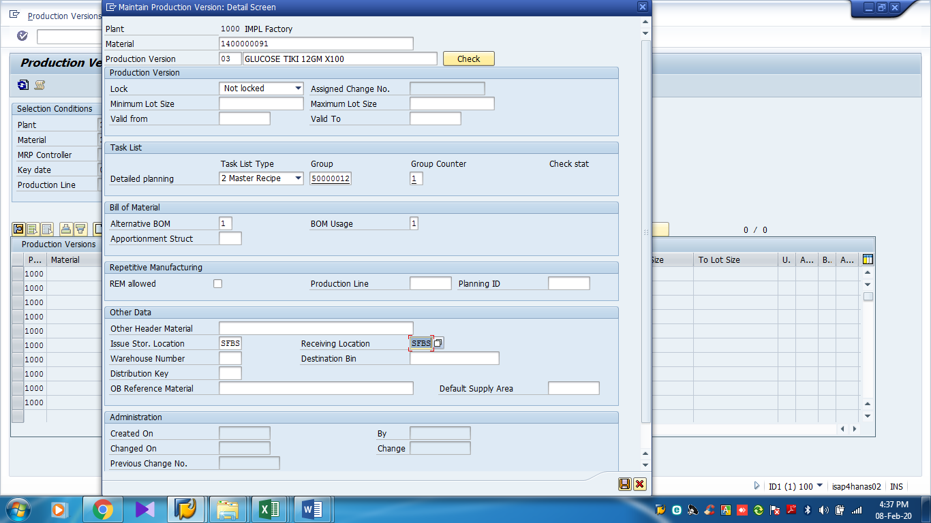
Production Version in SAP (C223) Cont….
Version No
Select Group
Select Recipe
Select BoM
Select Production Store Loc

Slide 21
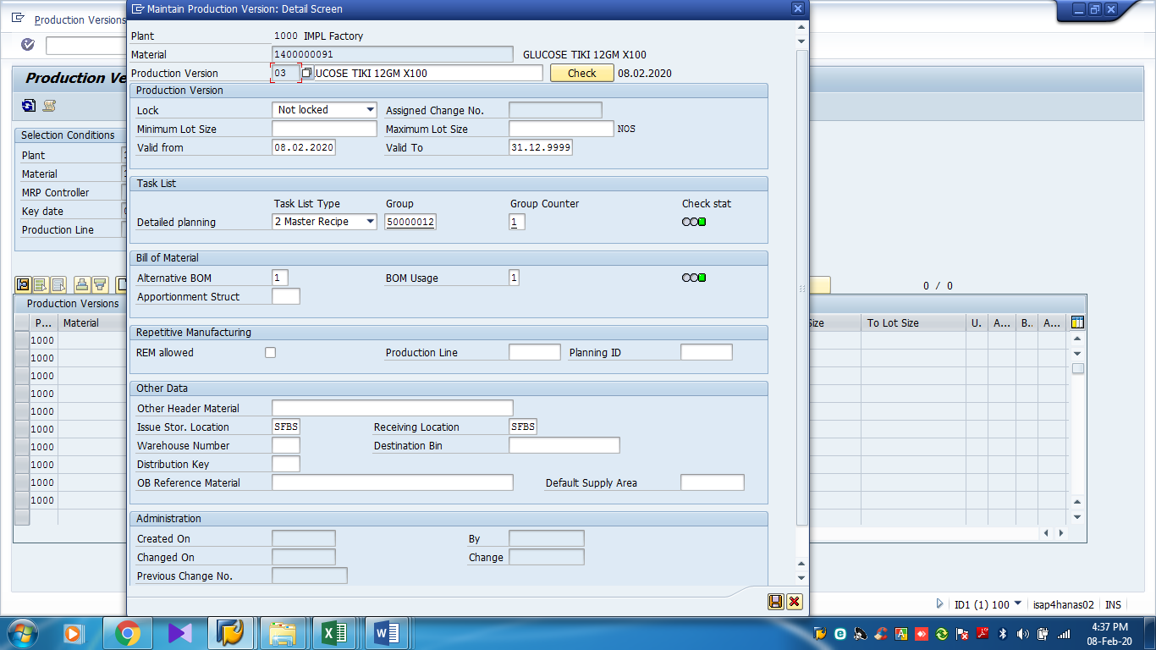
Production Version in SAP (C223) Cont….
Check
& save

Slide 22
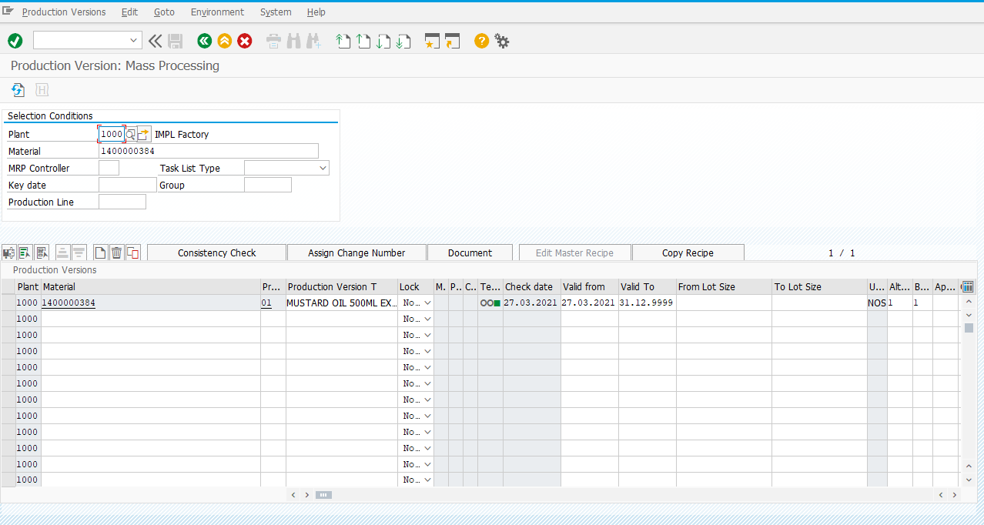
Production Version in SAP (C223) Cont….
After that Save the version

Slide 23
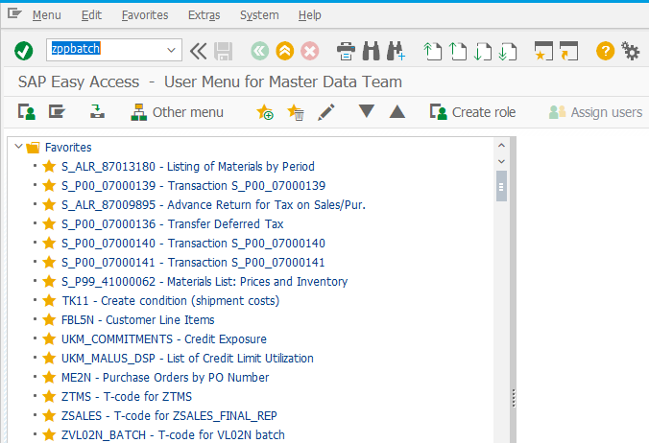
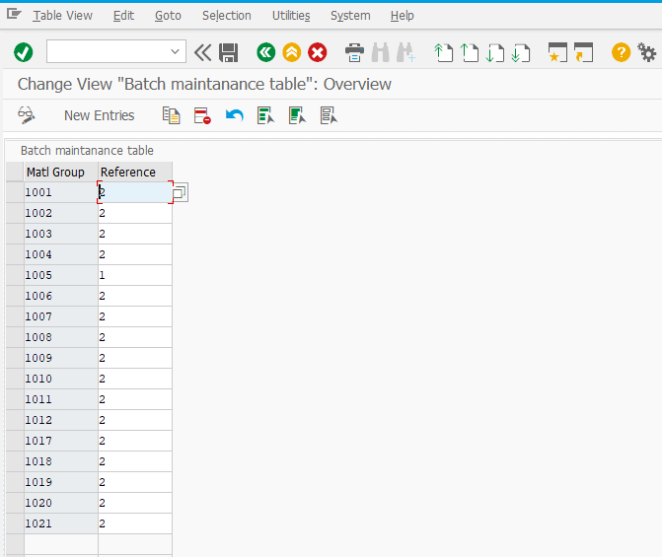
ZPPBATCH
Click on ZPPBATCH
Enter New Material Group
Reference 1= 7 days Batch
Reference 2= 30 days Batch

Slide 24

Quality Module

Slide 25
QM Module Process Flow
RM
PM
FG Order Conformation
Result Recording & Usage Decision
QA32
Quality Inspection Report
ZQM_INSP
STOCK
MMBE (Individual)
MB52 (ALL)

Slide 26
QM Module Master Data Maintain
Quality Parameter Creation (QS21)
Assign Quality Plan for RM, PM and FG. (QP01)
Quality Inspection Report
ZQM_INSP
Release RM, PM & FG after completing quality Inspection. (QA32)

Slide 27

Quality Parameter Creation (QS21)
Two Types of Quality Parameter:
1. Quantitative
2. Qualitative

Slide 28
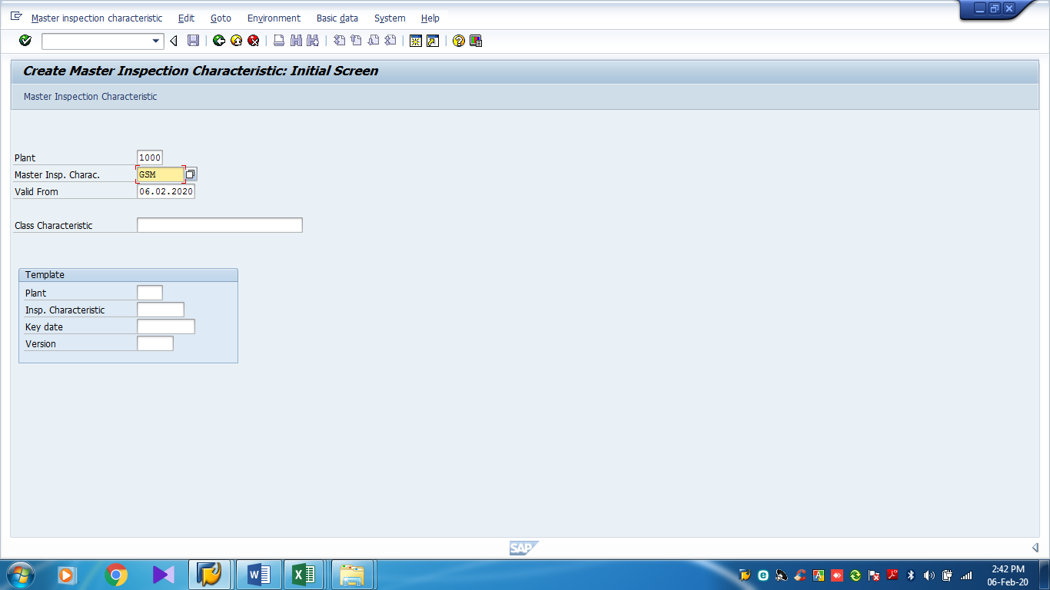
Quality Parameter Creation (QS21) for Quantative
Hit QS21
Master Insp. Charac. : Name of the Parameter (Max length: 8 Character)

Slide 29
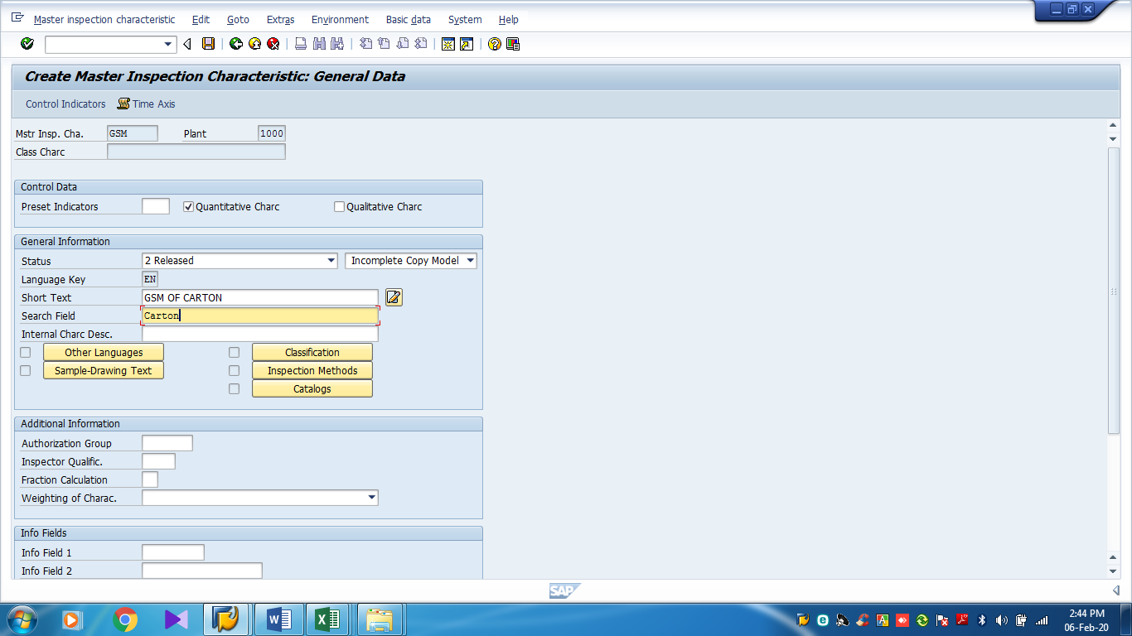
Quality Parameter Creation (QS21) for Quantative cont….
Tick on Quantative
Select Incomplete copy Model
Status: Released
Short Text: Full name of parameter
Search Field: A portion of full name will used in searching the parameter.

Slide 30
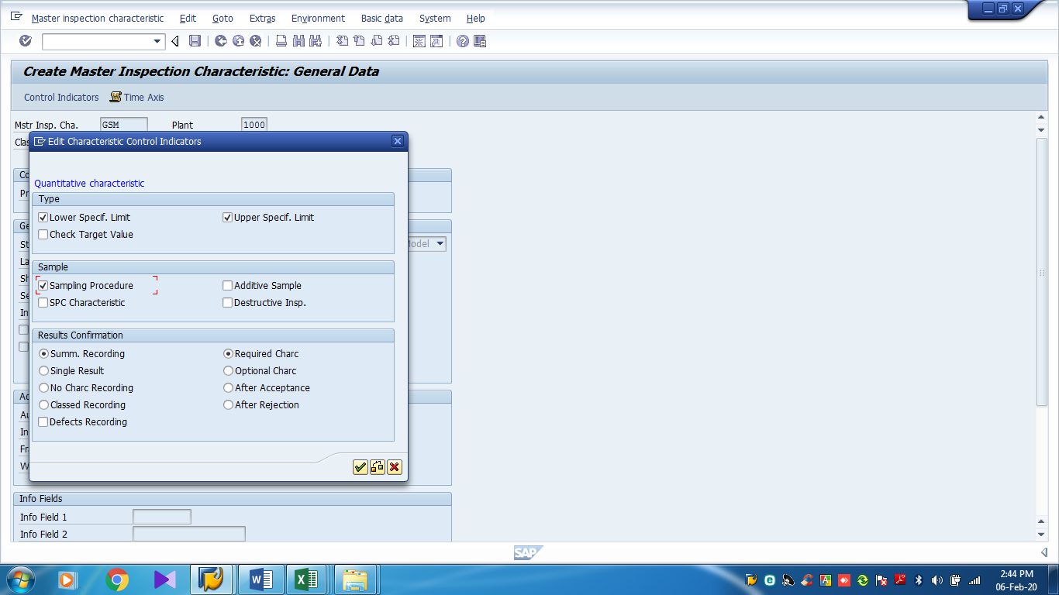
Quality Parameter Creation (QS21) for Quantative cont….
Check Tick on
Lower Specf. Limit
Upper Specf. Limit
Sampling Procedure
Sum Recording
Required Charc

Slide 31
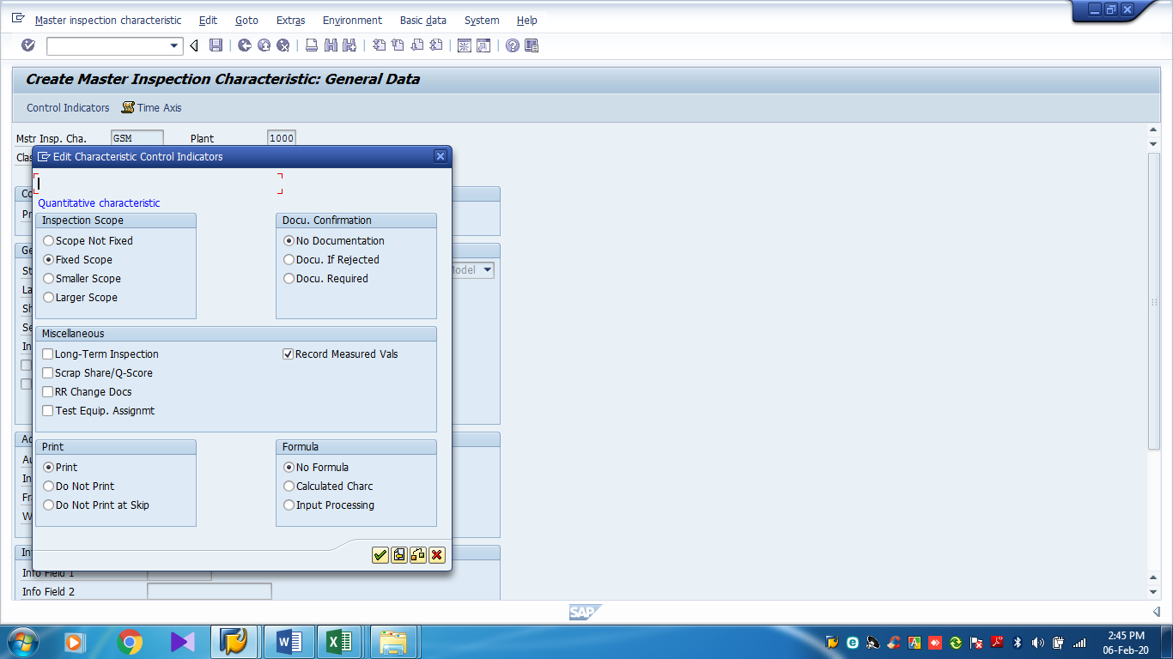
Quality Parameter Creation (QS21) for Quantative cont….
Check Tick on
Fixed Scope
No Documentation
Record Measured Vals
Print
No Formula

Slide 32
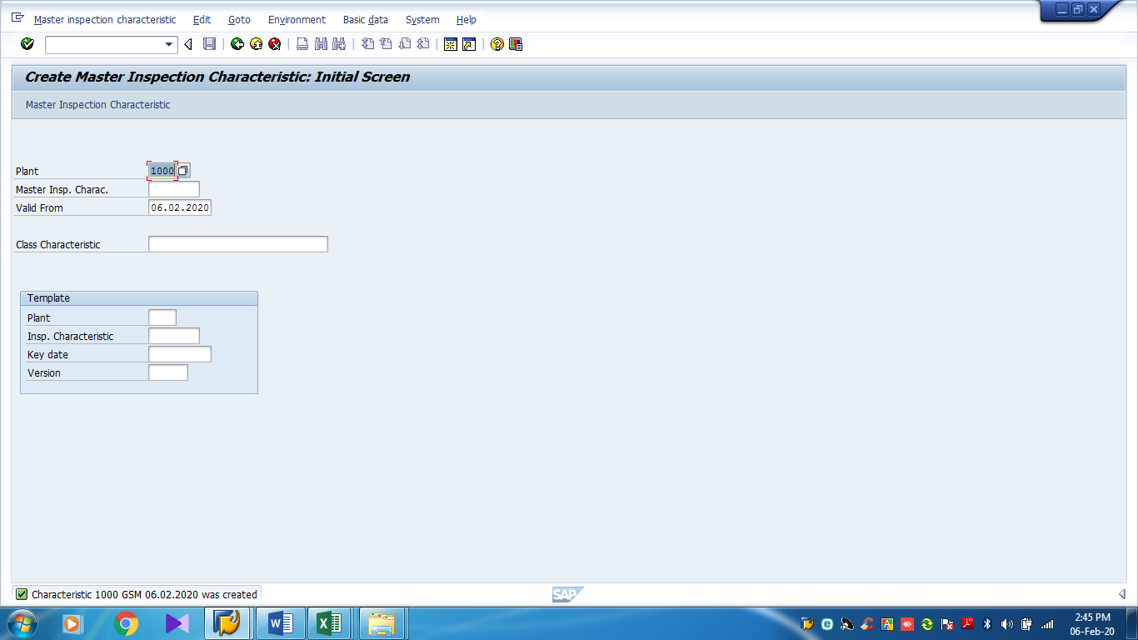
Quality Parameter Creation (QS21) for Quantative cont….
After that Save the parameter and will shows created.

Slide 33
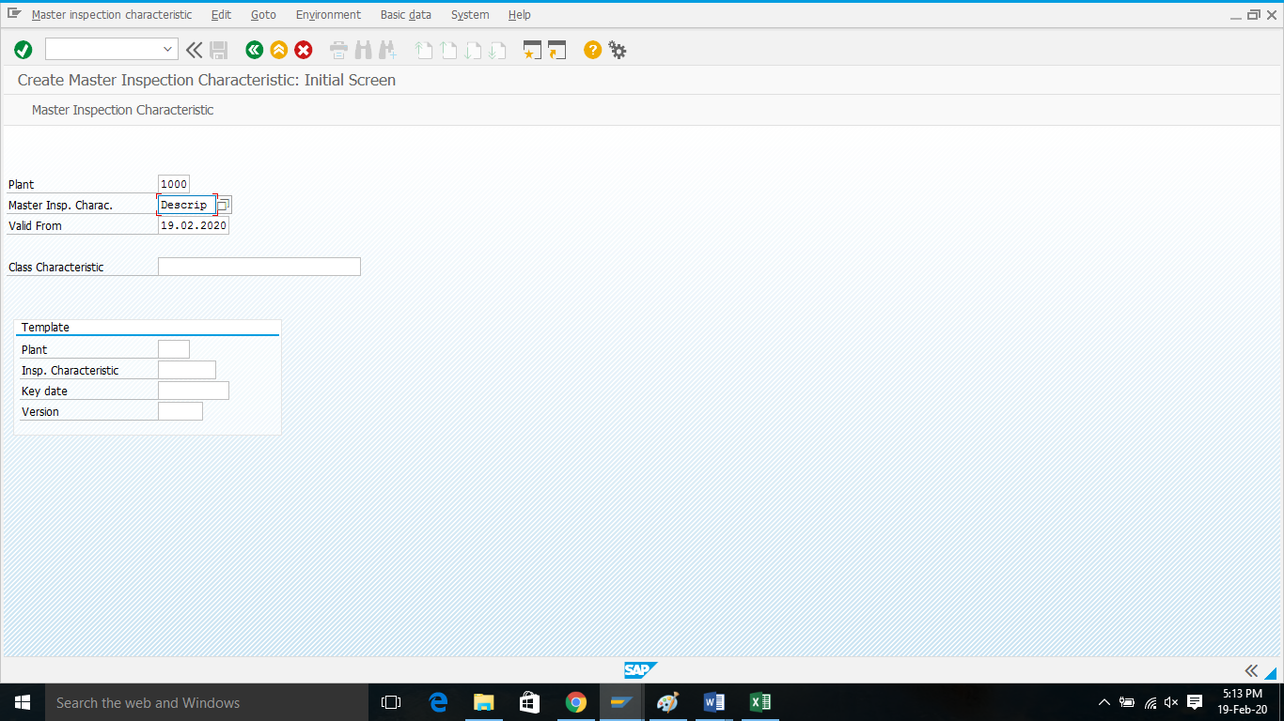
Quality Parameter Creation (QS21) for Qualatative
Hit QS21
Master Insp. Charac. : Name of the Parameter (Max length: 8 Character)

Slide 34
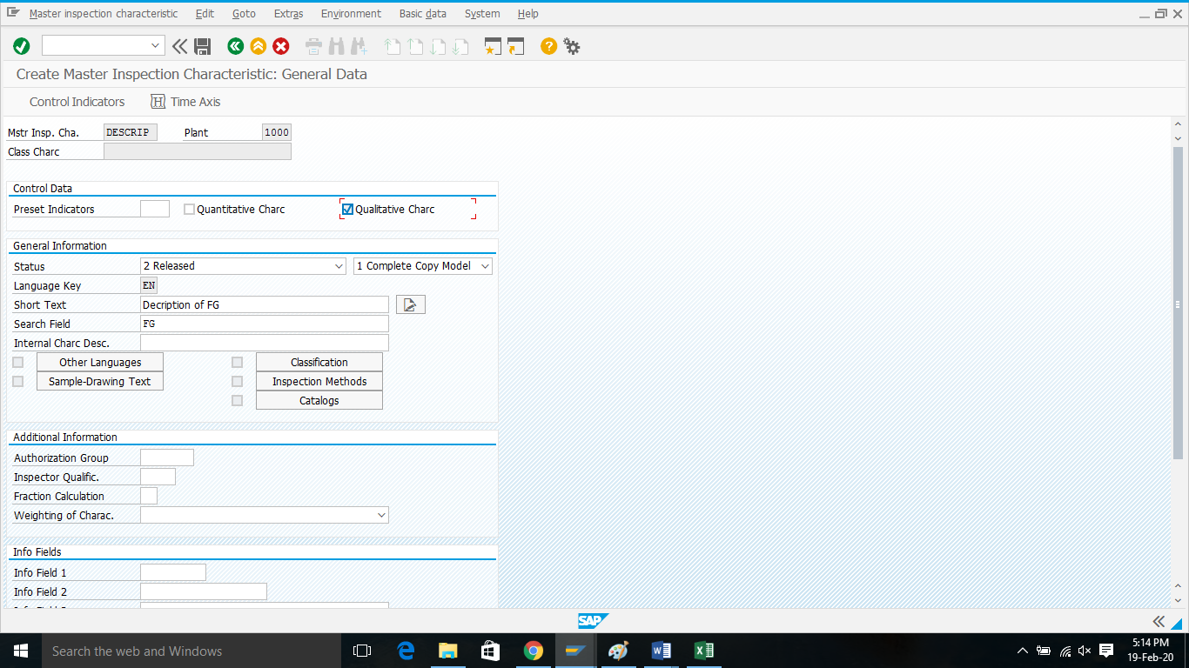
Quality Parameter Creation (QS21) for Qualatative Cont…
Tick on Qualatative
Select complete copy Model
Status: Released
Short Text: Full name of parameter
Search Field: A portion of full name will used in searching the parameter.

Slide 35
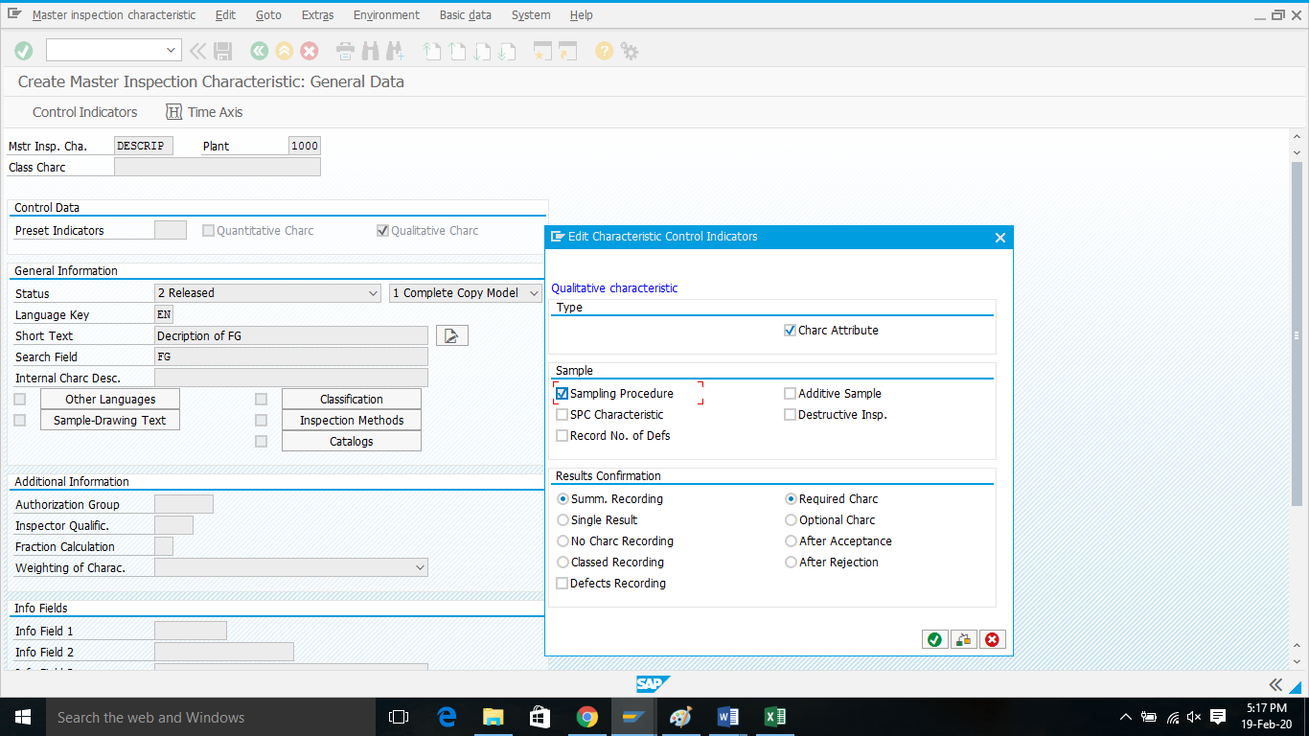
Quality Parameter Creation (QS21) for Qualatative Cont…
Check Tick on
Char Attribute
Sampling Procedure
Sum Recording
Required Charc

Slide 36
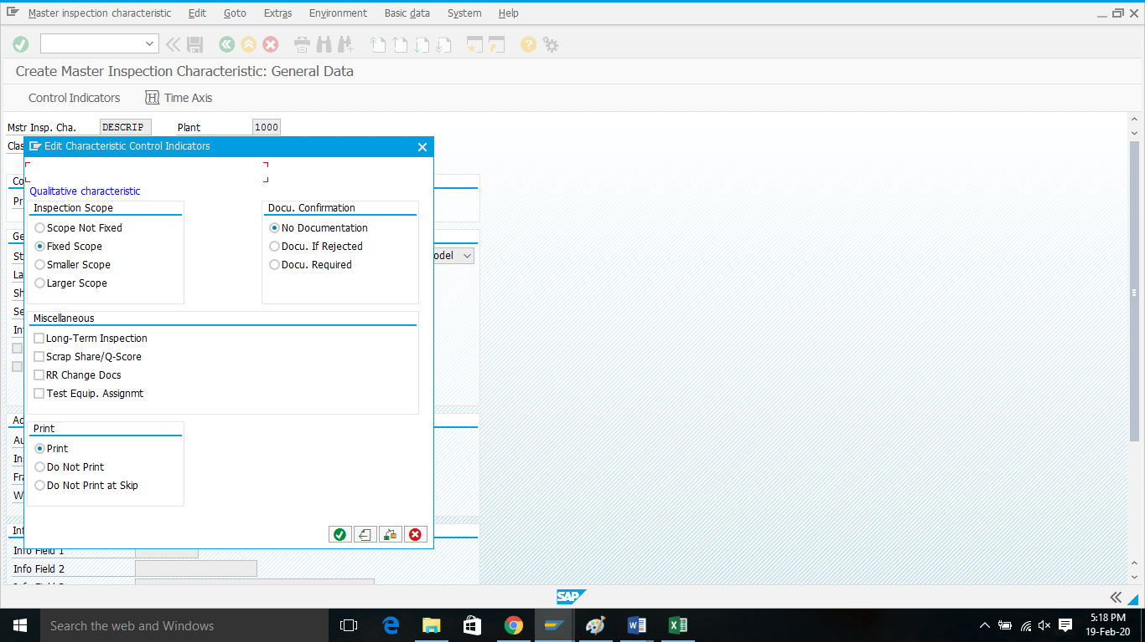
Quality Parameter Creation (QS21) for Qualatative Cont…
Check Tick on
Fixed Scope
No Documentation
Print

Slide 37
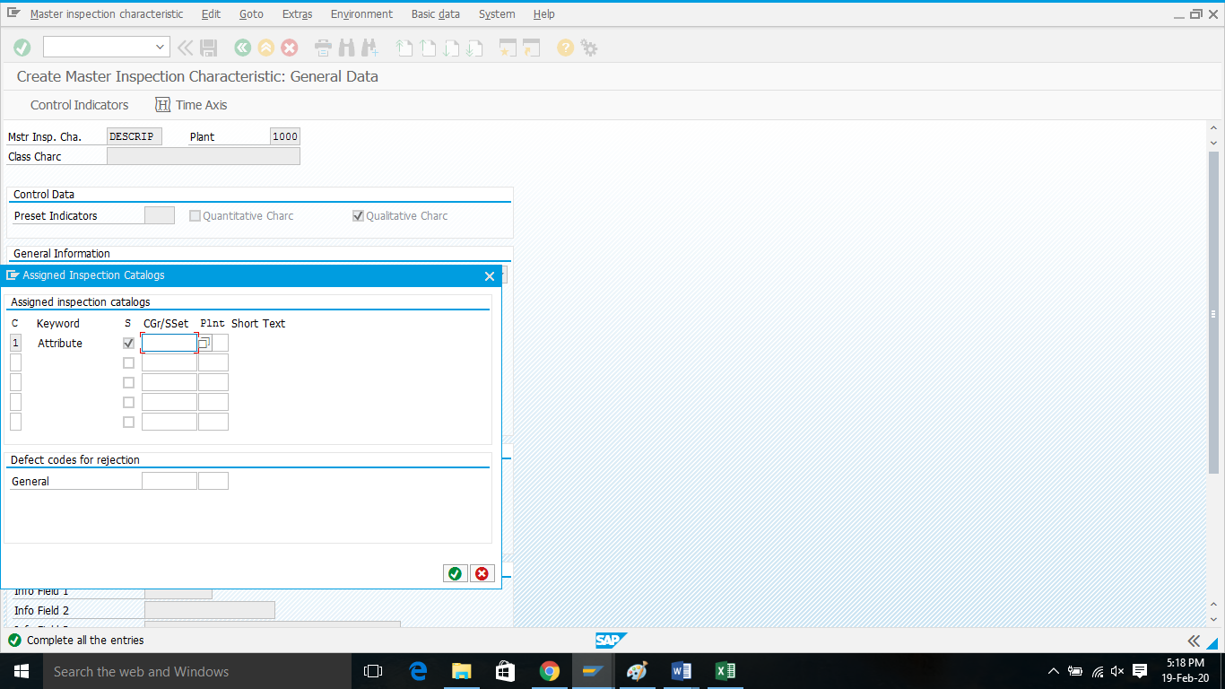
Quality Parameter Creation (QS21) for Qualatative Cont…
This Attribute field will appear.

Slide 38
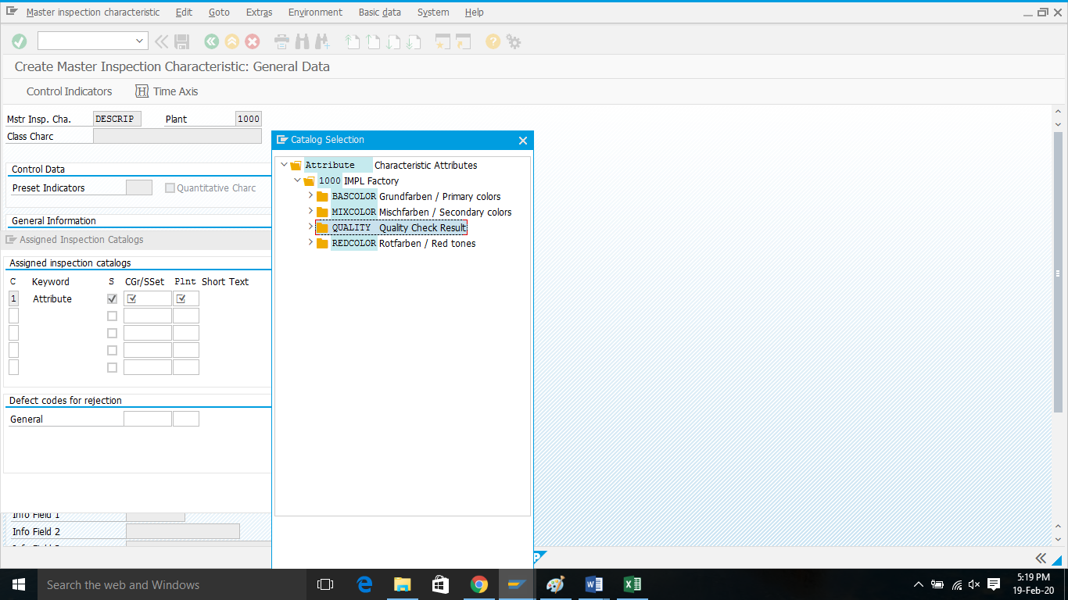
Quality Parameter Creation (QS21) for Qualatative Cont…
Browse Quality Check Result

Slide 39
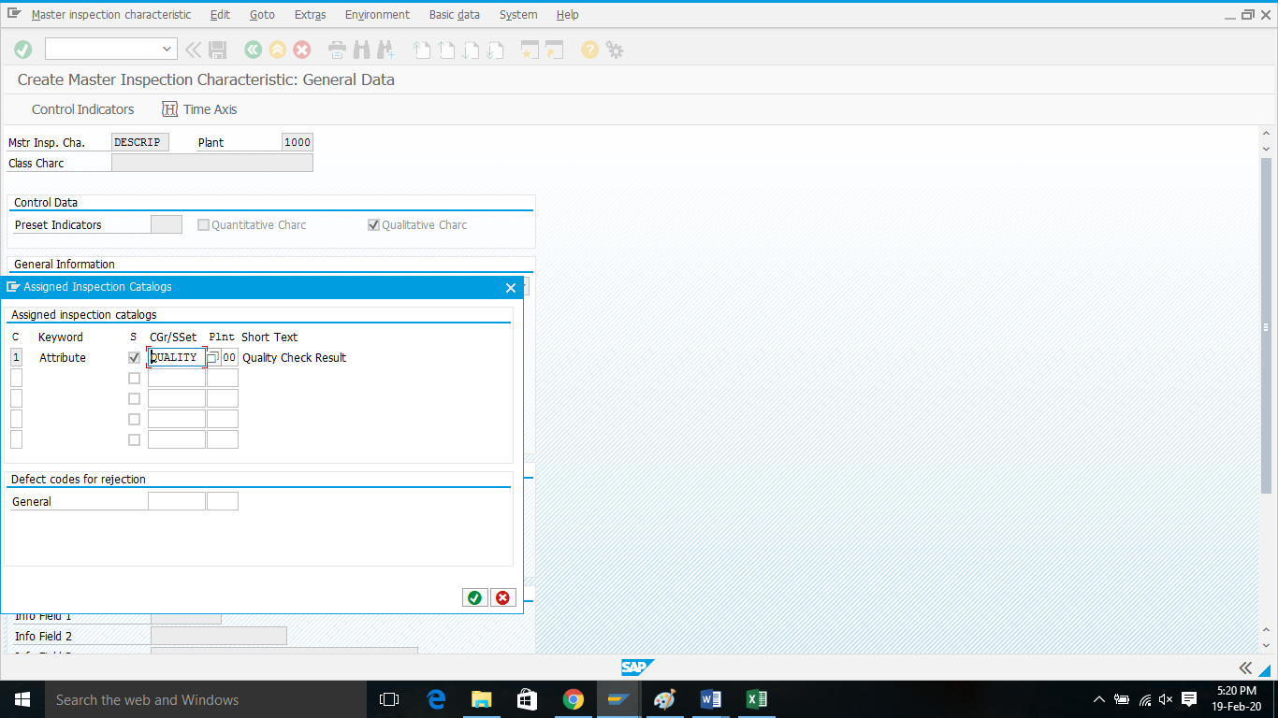
Quality Parameter Creation (QS21) for Qualatative Cont…
Select Quality here

Slide 40
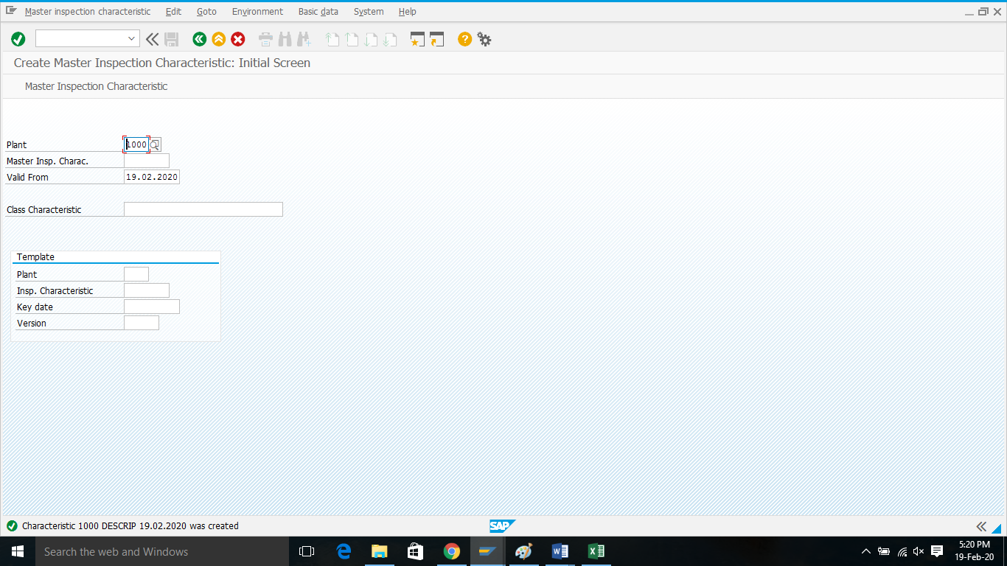
Quality Parameter Creation (QS21) for Qualatative Cont…
Save it, Parameter will be created.

Slide 41
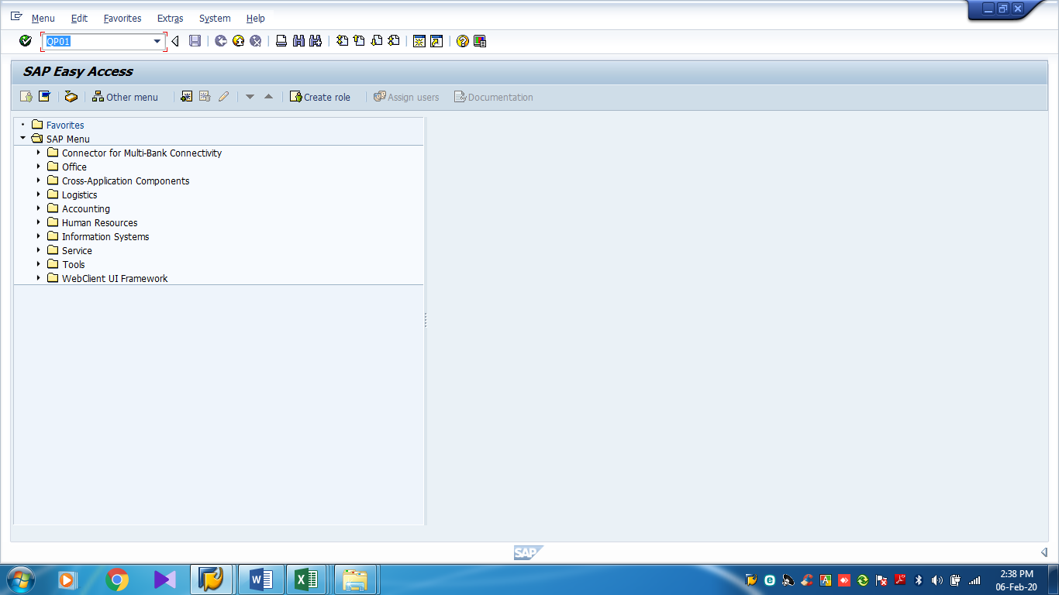
Quality Plan Assignment (QP01)
Hit QP01

Slide 42
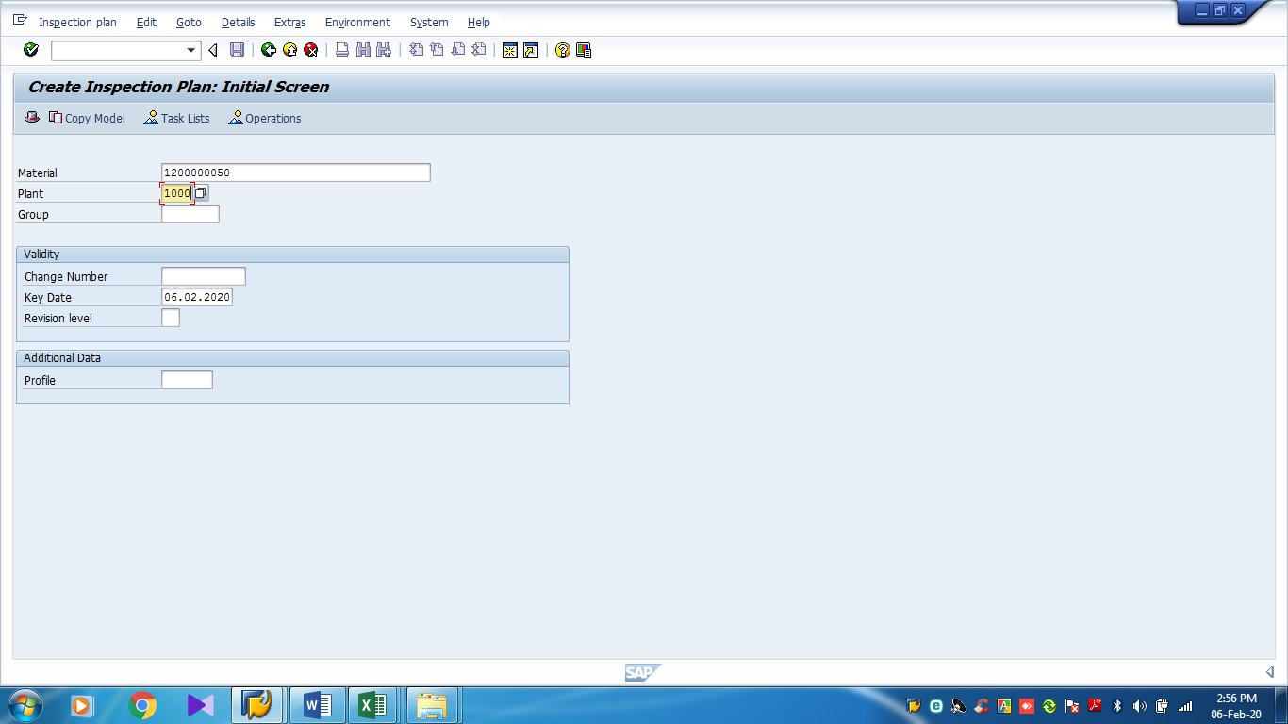
Quality Plan Assignment (QP01) Cont…
Select Material
Select Plant & Enter

Slide 43
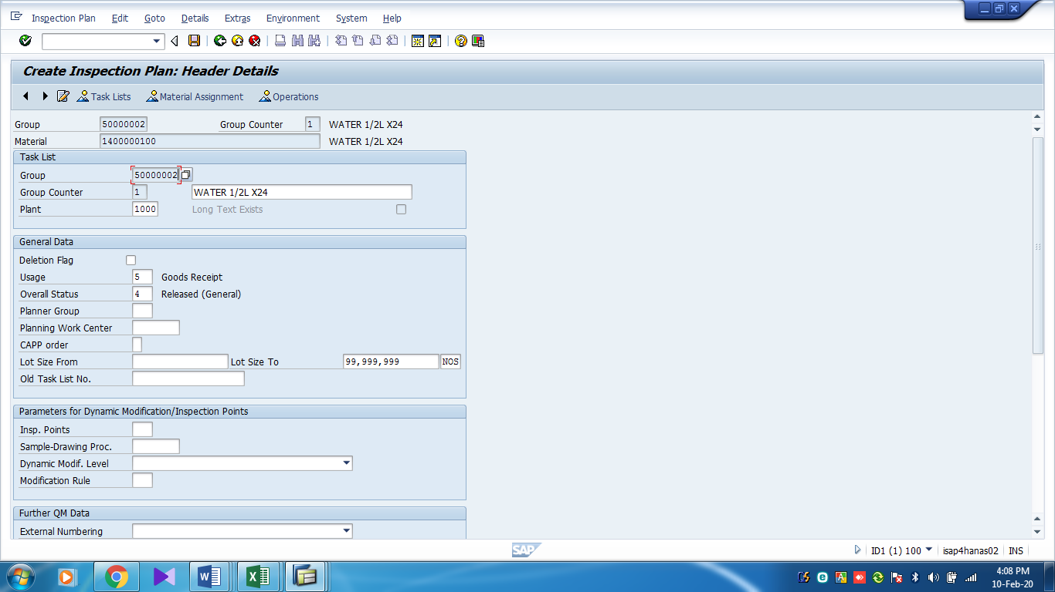
Quality Plan Assignment (QP01) Cont…
Usage: Good Receipt
Overall Status: released General

Slide 44
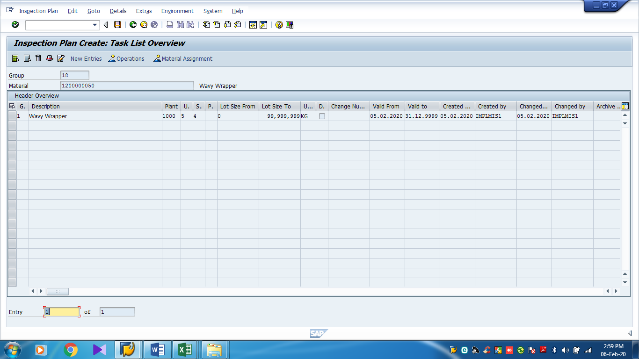
Quality Plan Assignment (QP01) Cont…
Go to Operations

Slide 45
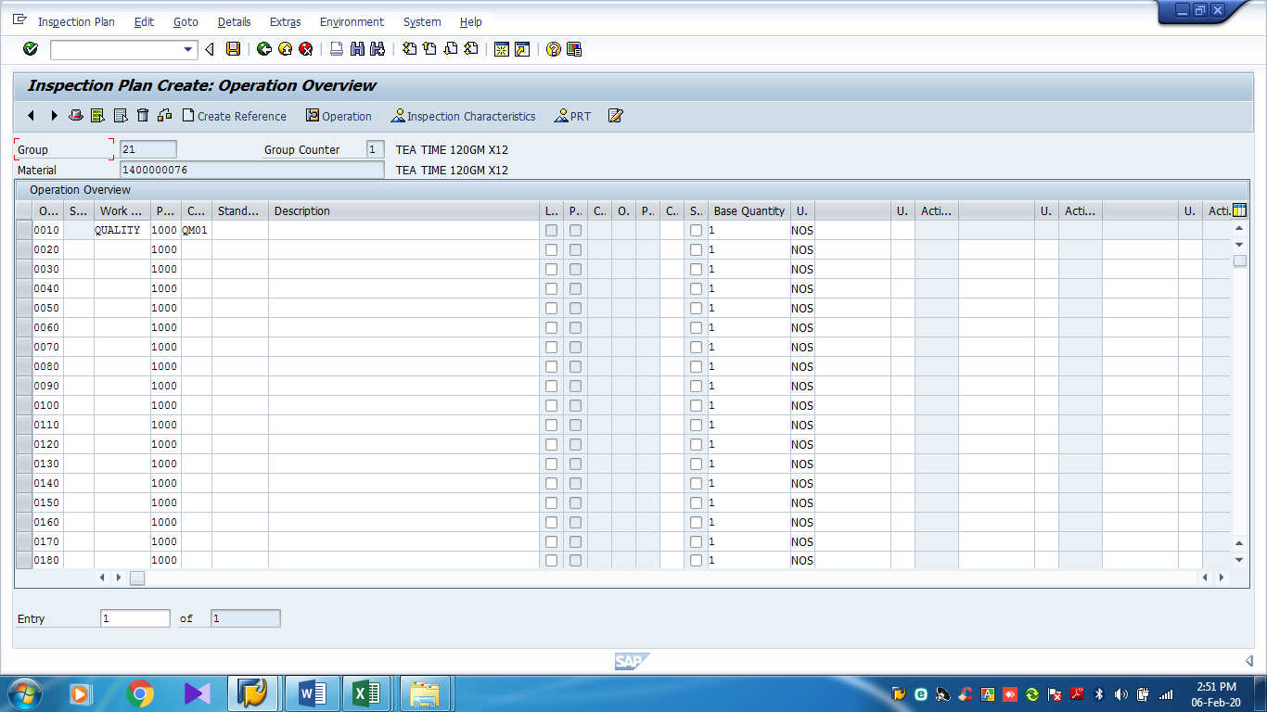
Quality Plan Assignment (QP01) Cont…
Go to Inspection Characteristics
Select Work Centre & Control Key

Slide 46
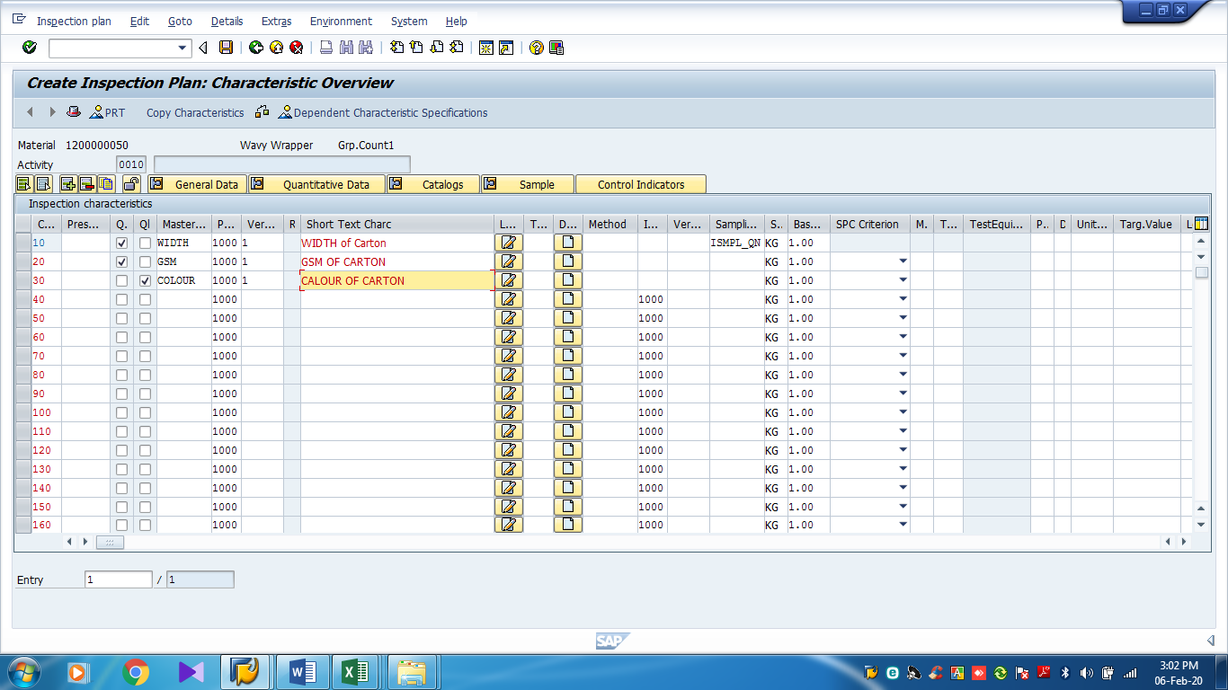
Quality Plan Assignment (QP01) Cont…
Then Save
Give Inspection Parameter & Give Value of Quantative Parameter

Slide 47

Result Recording & Usage Decision (QA32)

Slide 48
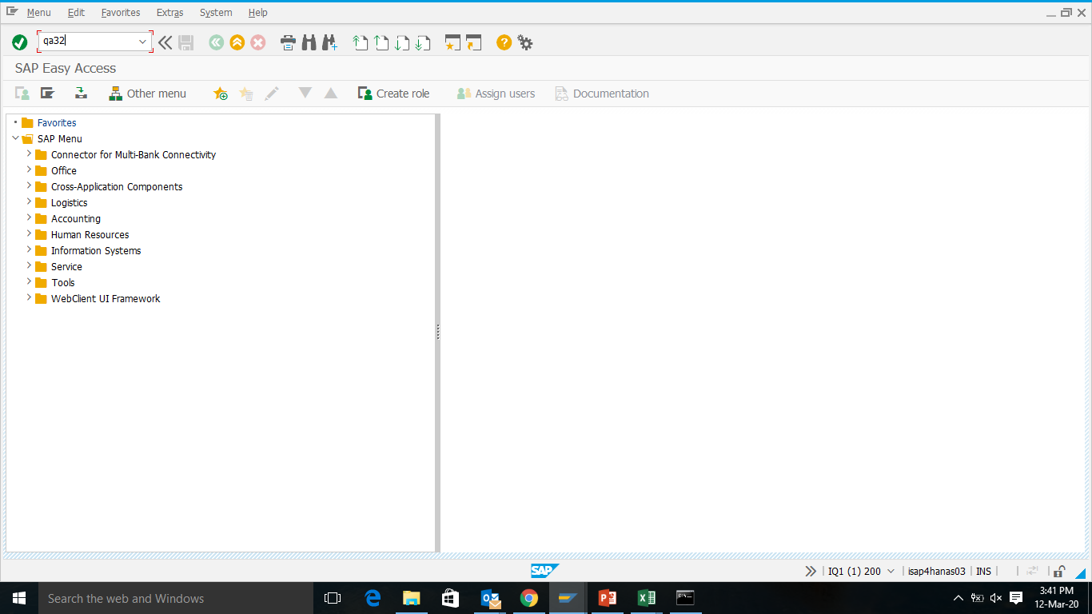
Quality Result/ Decision (TCODE: QA32)
HIT QA32

Slide 49
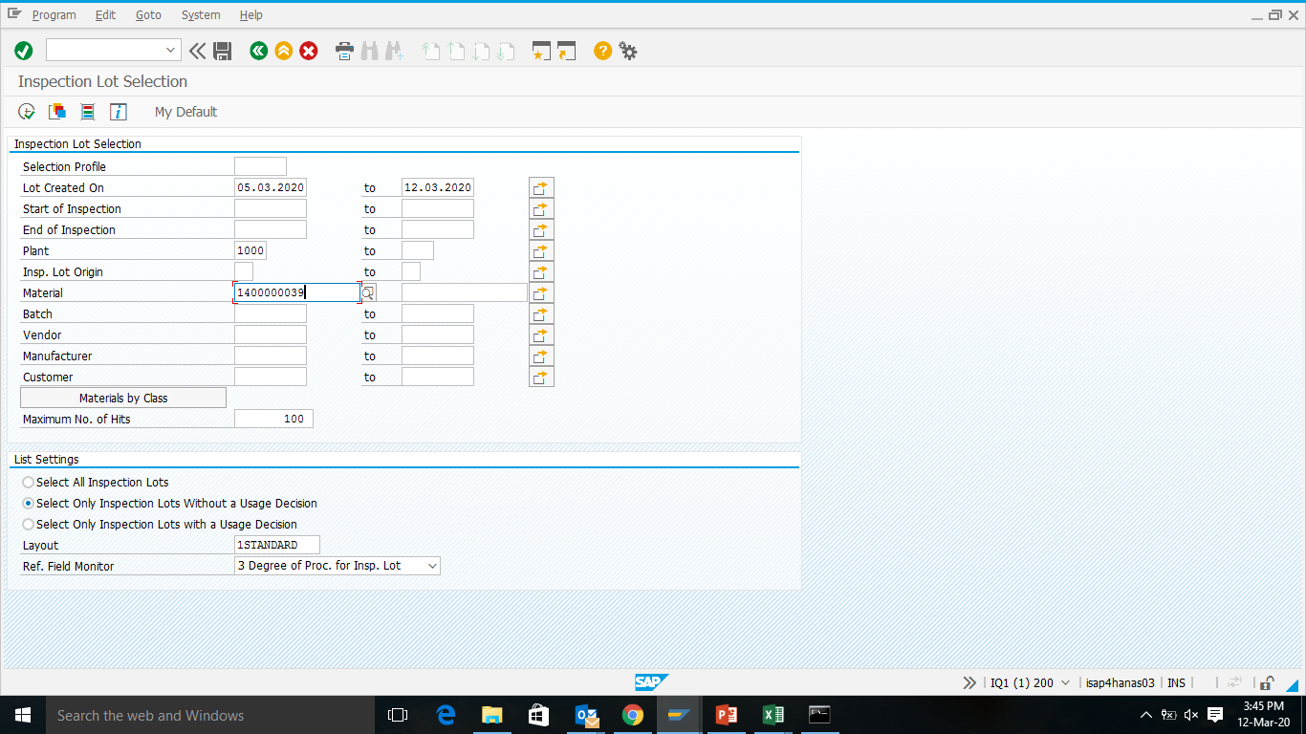
TCODE: QA32 Cont….
You can customize by selecting date
Click Execute
Giving Plant is mandatory
Material code is your choice

Slide 50
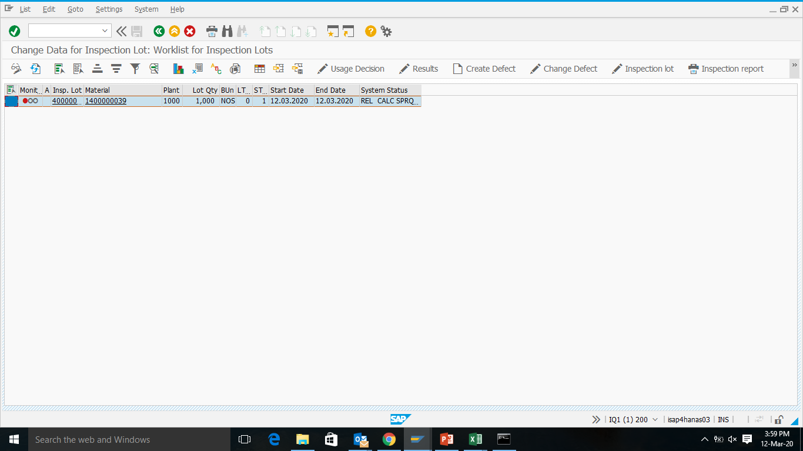
TCODE: QA32 Cont….
Select the material
Click on result

Slide 51
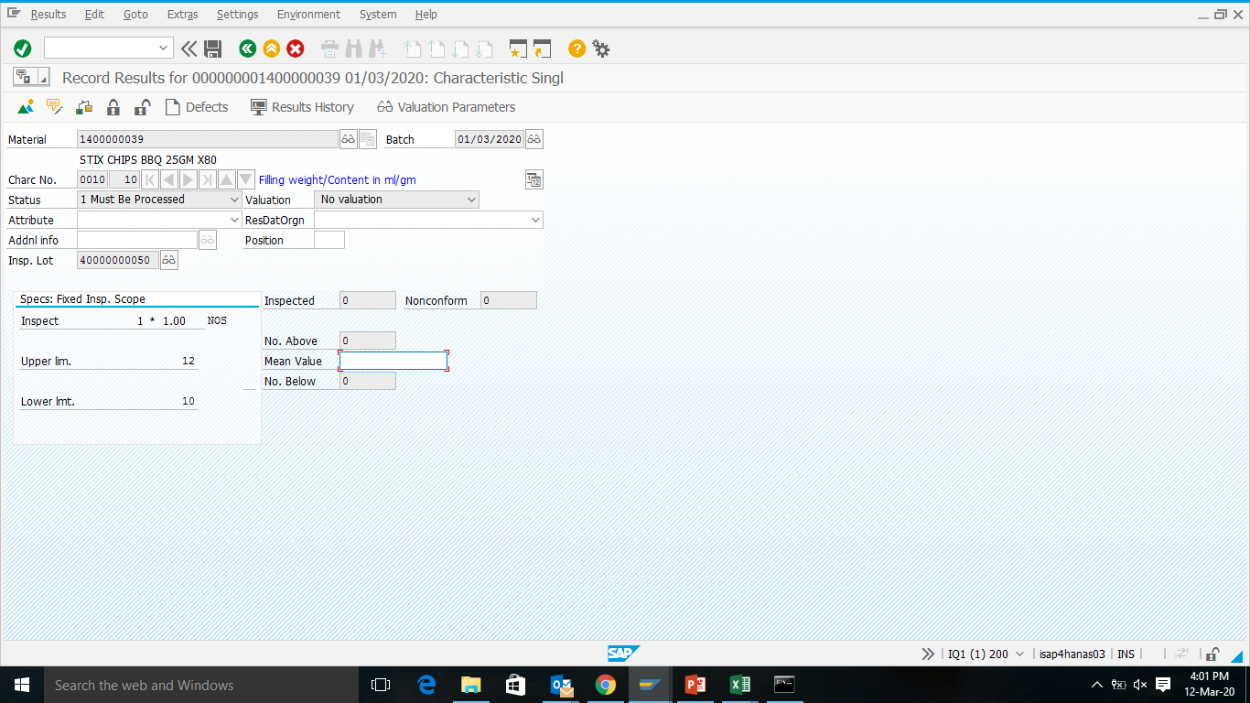
TCODE: QA32 Cont….
Click on Back

Slide 52
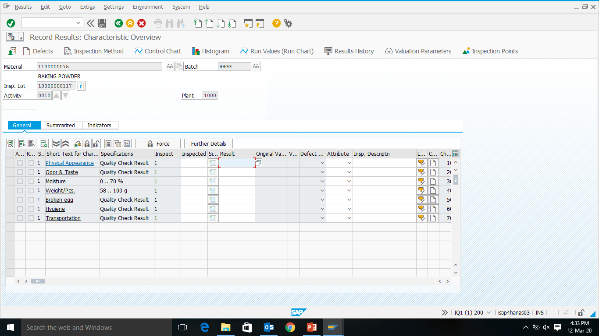
TCODE: QA32 Cont….
Result
Paramete
Specifications

Slide 53
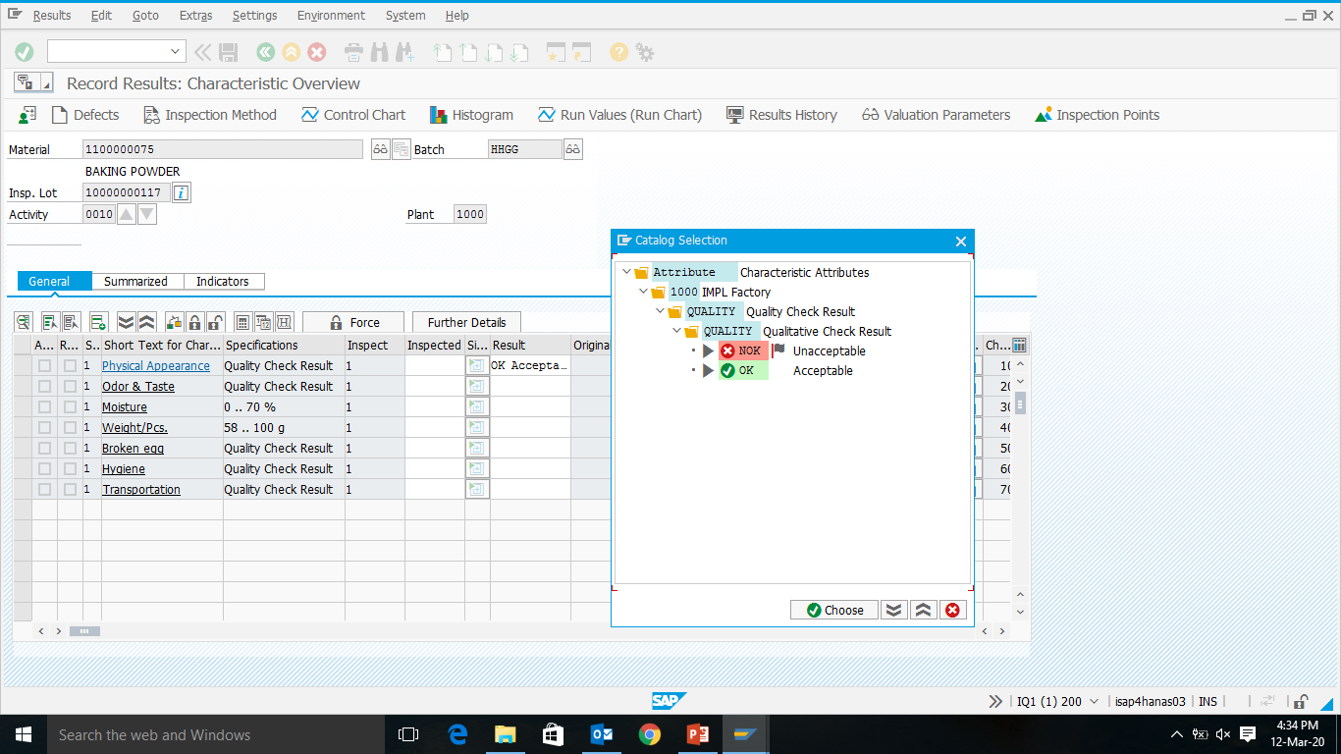
TCODE: QA32 Cont….
Acceptable / Unacceptable (For Qualitative)

Slide 54
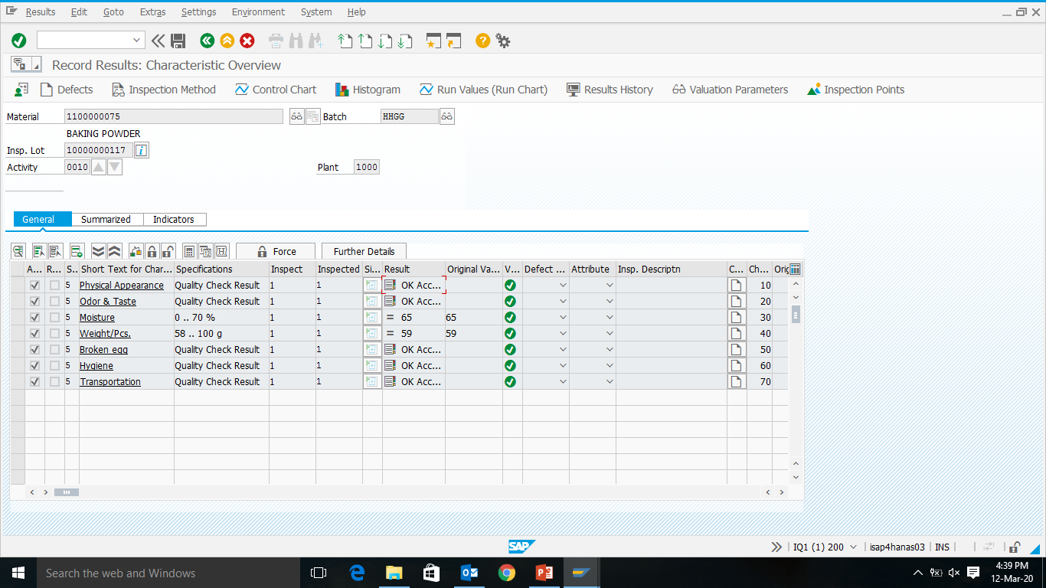
TCODE: QA32 Cont….
Quantitative Value
Qualitative Value

Slide 55

TCODE: QA32 Cont….
Usage Decision

Slide 56

TCODE: QA32 Cont….
Click on UD Code (Accept/ Reject)

Slide 57

TCODE: QA32 Cont….
Click on Inspection Lot Stock

Slide 58

TCODE: QA32 Cont….
To Unrestricted Use= All Accepted

Slide 59
TCODE: QA32 Cont….
Save it

Slide 60

PP Module

Slide 61
PP Module Process Flow
FG
Planning Independent Requirement- PIR
BOM
MRP Running
RM
PM
MRP Result
Plan Order (FG & SFG)
Purchase Requisition (RM & PM)
Order Release
Report
(COOISPI)
QC Checking QA32
Order Conformation (COR6N)
Stock Transfer MIGO (311 Mov)
Component List (ZPPSHOP)

Slide 62
Master Data in PP
Material Master
BOM
Production Version
Master Recipe
Resource/ Work Center

Slide 63
Bill of Material (BOM)
A bill of material is a complete, formally structured list of the components that make up a product or assembly.
The list contains a description and object number for each component, together with the quantity and unit of measure.

Slide 64
Structure of BOM
FINISHED GOOD
(-) Bi-Product
RAW MATERIAL
PACKAGING
SEMI FINISHED GOODS
RAW MATERIAL
PACKAGING
(-) Bi-Product

Slide 65

BOM in SAP (CS01)
Hit CS01

Slide 66

CS01 Cont…..
Material Code
Plant:1000
Usage:1

Slide 67

CS01 Cont….
Give Quantity
Select Material Code
Select L (Stock Item)

Slide 68

CS01 Cont…..
Go to Header

Slide 69

CS01 Cont….
Select Base Quantity

Slide 70

CS01 Cont….
Select Item

Slide 71

CS01 Cont…..
Go to Item

Slide 72

CS01 Cont…..
save
Give Shop Floor Location

Slide 73

Process Order Conformation (COR6N)

Slide 74

Order Conformation (TCODE: COR6N)
COR6N

Slide 75

TCODE: COR6N Cont….
Give Order Number then click enter

Slide 76

TCODE: COR6N Cont….
Shows Order Qty (Put Here Actual Production quantity)

Slide 77

TCODE: COR6N Cont….
Actual Production Qty
Click Here

Slide 78

TCODE: COR6N Cont….
Now Click on goods movement

Slide 79

TCODE: COR6N Cont….
Click Browse Icon Here then click enter

Slide 80

TCODE: COR6N Cont….
Now gie the current date that will show black

Slide 81

TCODE: COR6N Cont….
FG Batch number will show by clicking backspace in Keyboard and enter
RM Batch number will show like this way
PM Batch number shows blank means PM Batch is not required

Slide 82

TCODE: COR6N Cont….
Save It

Slide 83

TCODE: COR6N Cont….
After saving it will show the below message (Failed:0, means conformation ok)

Slide 84

Material Requirement Document (TCODE: ZPPSHOP)
Enter ZPPSHOP

Slide 85

TCODE: ZPPSHOP Contd…
Then Execute
Process Order Number
Plant : 1000 (IMPL)
2000 (ISCL)
3000 (IHCL)

Slide 86

TCODE: ZPPSHOP Contd…
Click on Browse Icon

Slide 87

TCODE: ZPPSHOP Contd…
Click on That

Slide 88

TCODE: ZPPSHOP Contd…
Select ZLOC

Slide 89

TCODE: ZPPSHOP Contd…
Click Print Preview

Slide 90

TCODE: ZPPSHOP Contd…
Process order number
Order Quantity
Confirm quantity
Order Qty- A
Confirm
Qty-B
A - B
All Reservation-C
Qty in Shop-D
C-D
Issue Qty by store

Slide 91


PR SYSTEM
Click on object
Click on me51n

Slide 92

PR SYSTEM Cont….
For “A” = F/A
“requisition”=name
“val. Pri”=unit price
“short text”=material name with dept.
“qty,unit,delivery date,material grp”= 1010
“plant & store loc”=1000 & SPAR
“PGR”=130(service purchase)
Fill up the G/L Acc. & Order for each item
Save then collect the PR number

Slide 93


Pending PR
Click on me5a
Pending PR

Slide 94

THANK YOU ALL

